Slide 1
Twitter Analysis using Heron
Streaming Coders
Gupta, Arunit
Patel, Marmikumar
Krishna, Naga
Reddy, Rakesh

Slide 2
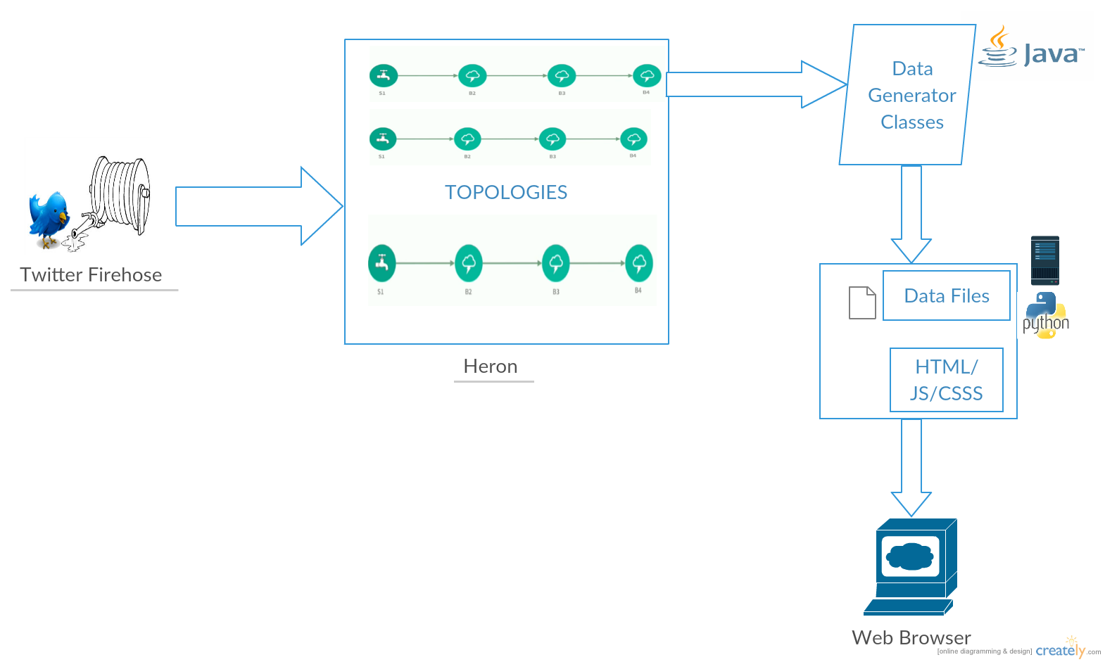
Architecture Diagram
Technologies:

Slide 3
Application Features
Web Application is powered by Heron which is a real-time, fault tolerant stream processing engine from twitter which is used to Analyze data.
Following are the features:
Application is capable of displaying top 25 trends using word cloud which displays words based on number of tweets .
It can Classify tweets based on metadata which breaks down by Android, IOS, Web and Facebook in form of Tree view.
Lastly, it can display trending tweets globally from different parts of world on a google heat map.

Slide 4
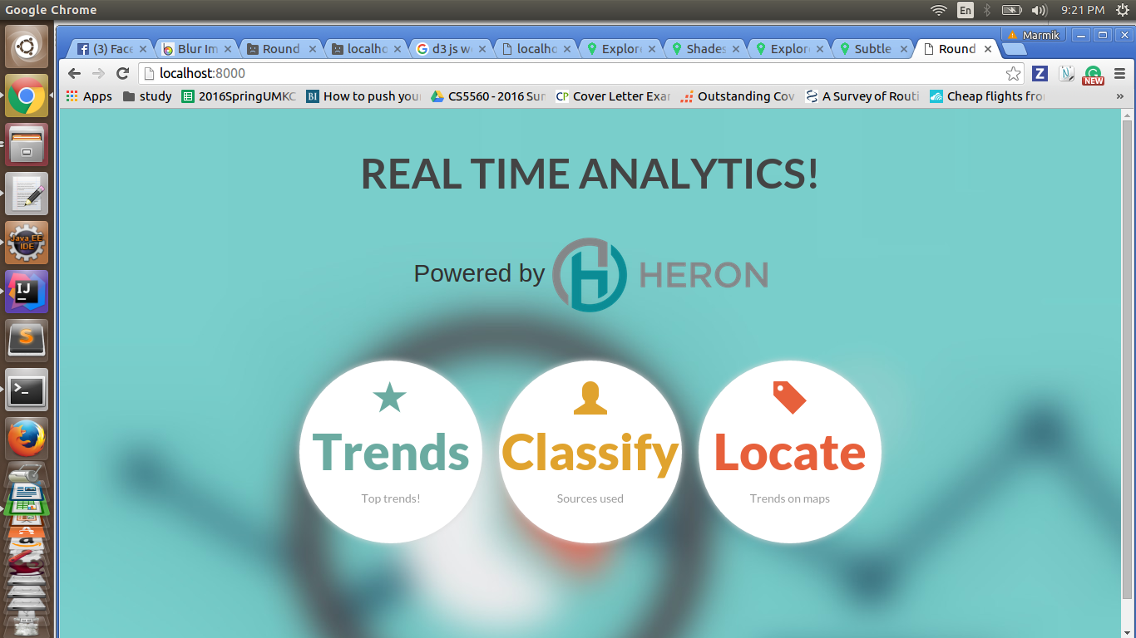
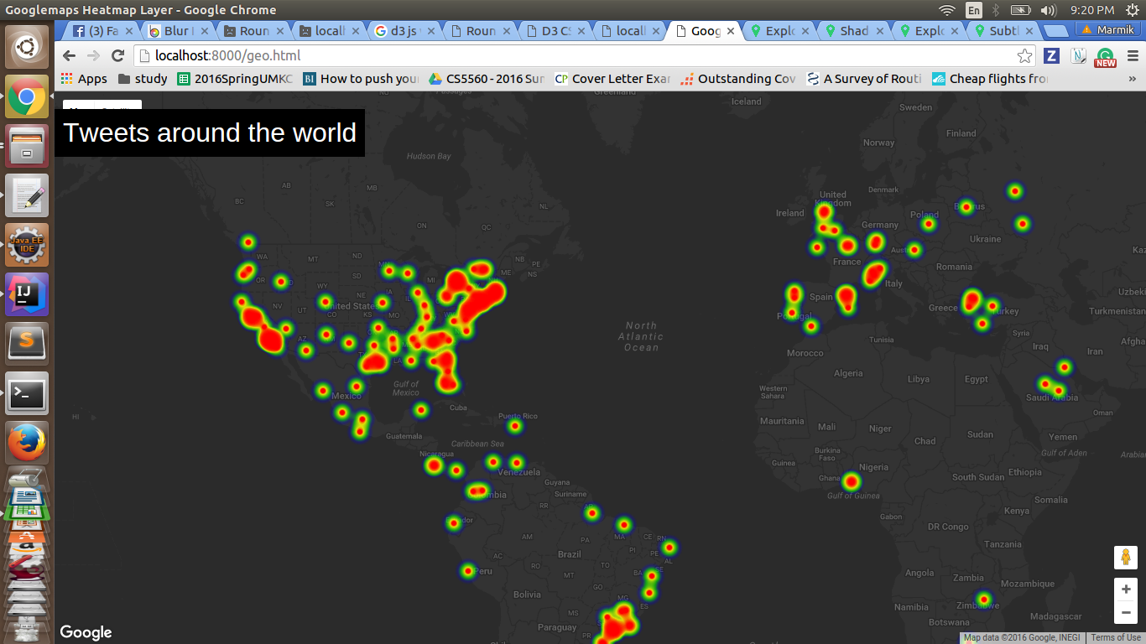
Screenshots

Slide 5
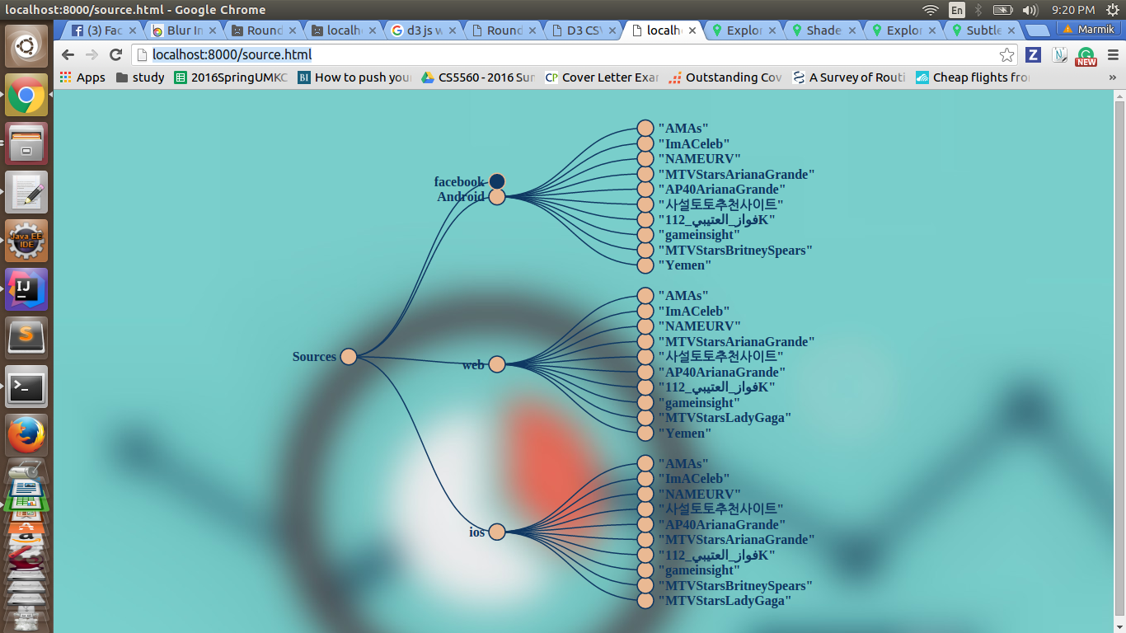
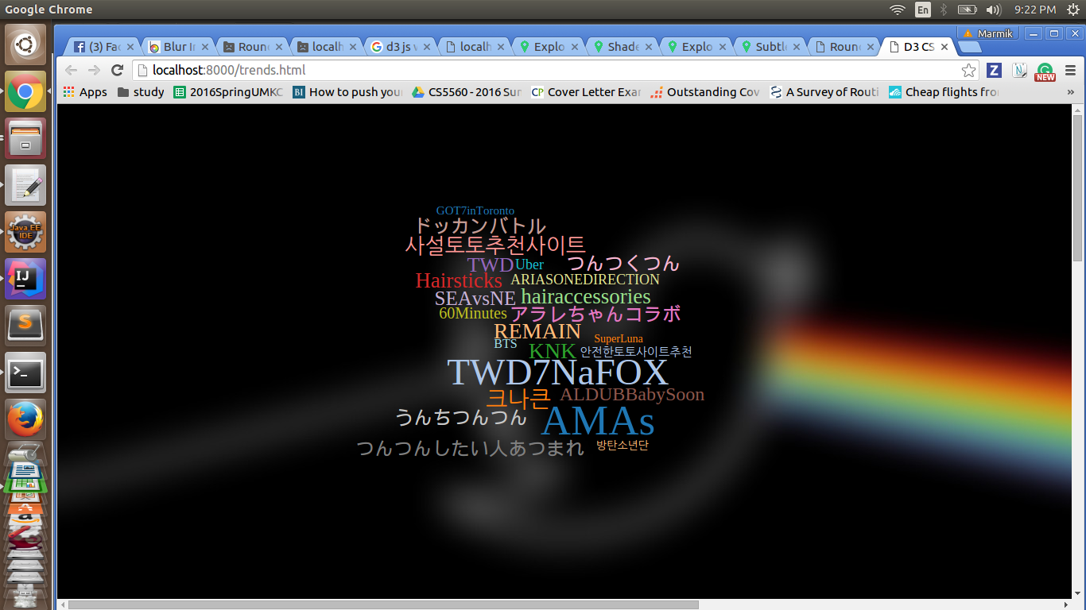
Screenshots

